Slide 1

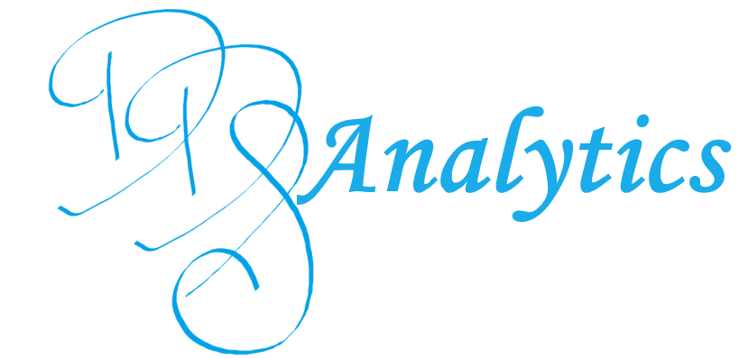
Frito-Lay Attrition Analysis
Trevor Kunz
Data Scientist
Notes:
DDS Analytics
Analytics Firms Specializing in Talent Management
Service
Attrition Analysis

Slide 2

Executive Summary
Frito-Lay has a 15.91% Attrition Rate
What variables are correlated with attrition?
How to predict attrition?
Notes:
We found FritoLay has a 15.91% Attrition Rate
Discuss which factors are correlated with Attrition
Is there a place for attrition at Frito Lay

Slide 3

Agenda
Model Methodology
Variable Selection
Model Analysis
Model Deployment
Recommendations
Questions
Notes:
Methodology behind our models
Open floor to questions

Slide 4


Attrition Model Methodology
Variable Selection
K-NN Model
Linear Regression Model
Evaluate Model Performance
Model Deployment
Notes:
Variable Selection
Compared all the variables and their correlation to Attrition
2 Models
K-NN
Linear Regression
Best Model for your needs

Slide 5

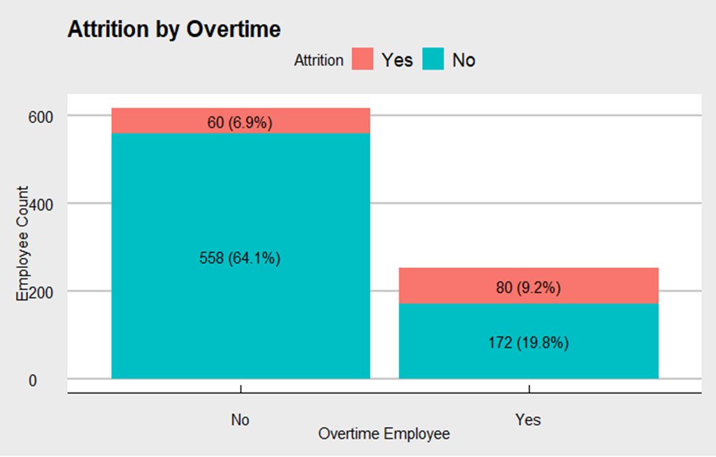
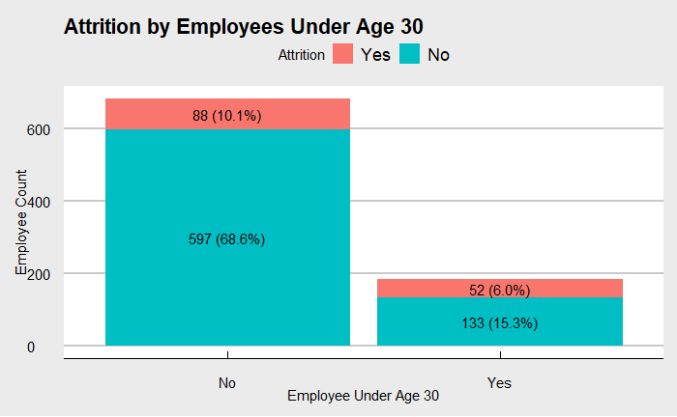
Positive Correlation
Overtime
Correlation: + 0.2720
Attrition in 31.7% of Overtime Employees
Attrition in 9.7% of Exempt Employees
Age Under 30
Correlation: +0.1700
Attrition Under 30: 28.1%
Attrition Over 30: 12.8%
Notes:
Discuss variables with the highest positive correlation
Overtime
Weak +0.272
Age Under 30
Weak +.17

Slide 6
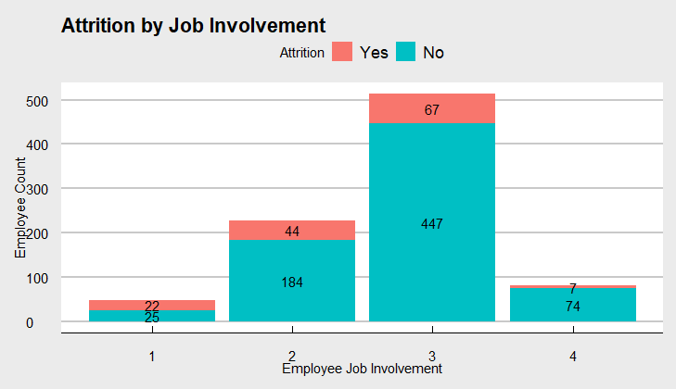
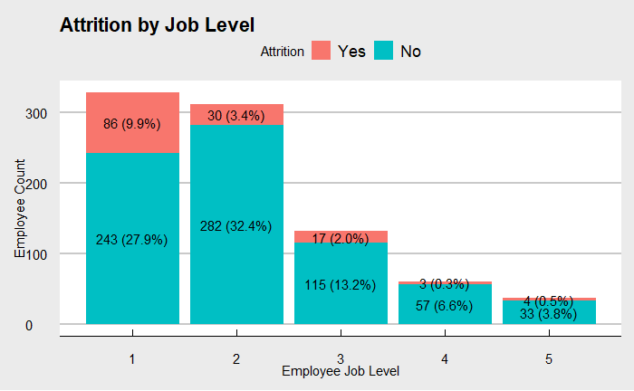
Negative Correlation
Job Involvement
Correlation: -0.1878
Highest Attrition: Level 1 – 46.8%
Lowest Attrition: Level 4 – 8.6%
Job Level
Correlation: -0.1621
Highest Attrition: Level 1 – 26.1%
Lowest Attrition: Level 4 – 5.0%
Notes:
Negative Correlation
Job Involvement
Weak -.18
Job Level
Weak -.16

Slide 7
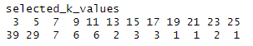
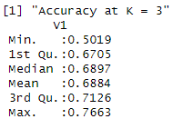
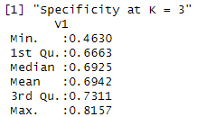

K-NN Model
K = 3 had the highest accuracy across 100 iterations of the model.
Used a lower threshold of .125 to improve sensitivity.
Notes:
K-NN Model predicts new records by comparing to the nearest data points or “Neighbors”
100 iterations to find how many neighbors to compare to
Imbalanced data set, so set lower threshold to trade true neg for true pos (+ sens, - spec)
Achieved deliverable of 60% S & Sp

Slide 8
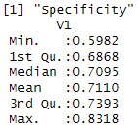
Model Analysis
The Regression Model was slightly more accurate than K-NN.
Regression Model has better Sensitivity.
Notes:
We compared data for one example to see how the data compared side by side
Agreed with 87.74% accuracy to each other
Disagreed on 32 records
Regression model has slightly better accuracy
Holding the thresholds constant between he two models, regression has better sensitivity and K-NN better Spec.
Predicting Regression, so Sens is preferrable

Slide 9
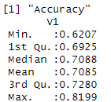

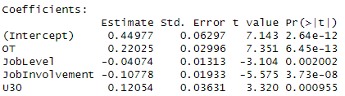
Linear Regression Model
Used to predict attrition on a scale of 0-1.
0 = Retention
1 = Attrition
Predicted values above .2 threshold predicted as Attrition.
Notes:
Linear Regression
Fits a line for each data point between 0 and 1
Lowered threshold to .2+ = attrition
Also met the 60% deliverable

Slide 10
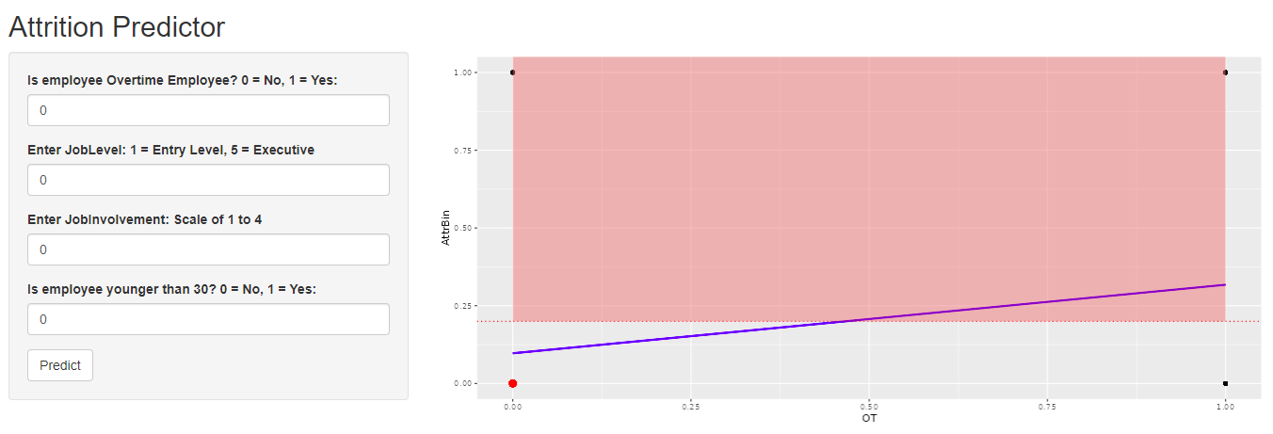
Linear Regression Model Deployment
Notes:
Linear Regression
Fits a line for each data point between 0 and 1
Lowered threshold to .2+ = attrition
Also met the 60% deliverable

Slide 11
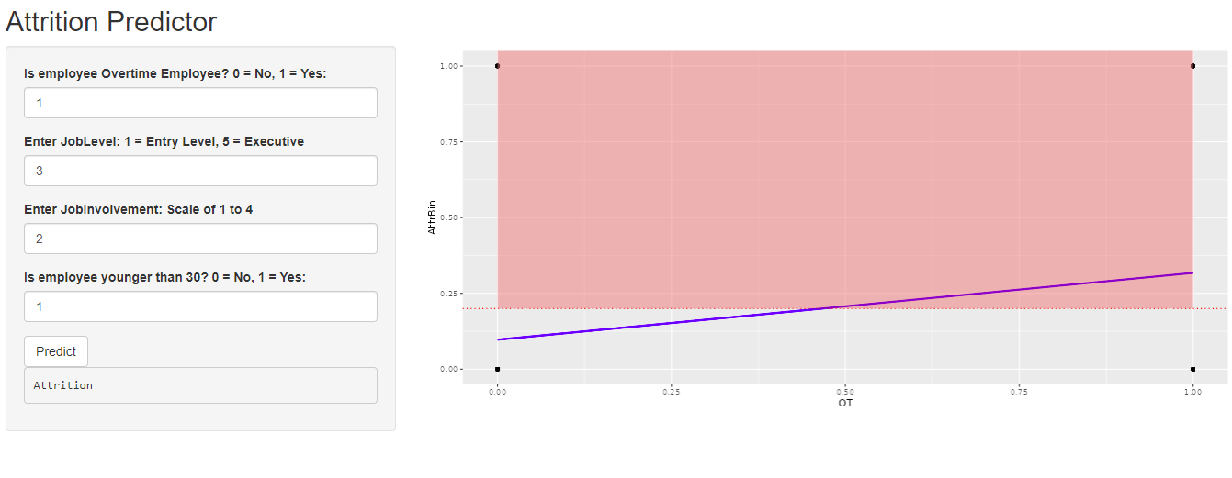
Linear Regression Model Deployment
Notes:
Linear Regression
Fits a line for each data point between 0 and 1
Lowered threshold to .2+ = attrition
Also met the 60% deliverable

Slide 12
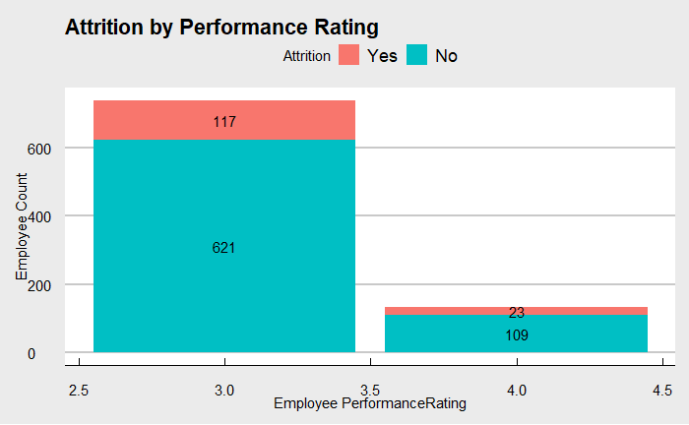
Recommendations
Performance Ratings only have 3’s and 4’s.
Traditional Bell Curve:
1: 0.13%
2: 15.73%
3: 68.26%
4: 15.73%
5: 0.13%
Performance Ratings:
3: 84.83%
4: 15.17%
Notes:
Only 3’s and 4’s
Most follow a traditional bell curve
4’s are aligned with he norm, but 2’s are buried in the 3’s.
Recommend restructuring the performance review system, to allow for Attrition for underperformers or give them a chance to improve.

Slide 13

Recommendations
Several variables are correlated with Attrition and Retention
Promote Job Involvement
Promotions to higher Job Levels
Conversion of Overtime Employees to Salaried Exempt
Notes:
Correlation not causation

Slide 14
Recommendations
Utilizing the R-Shiny Dashboard to better understand attrition risk in workforce planning.
Create more smiles with every sip and every bite.
Notes:
Correlation not causation

Slide 15

Questions?
tkunz@mail.smu.edu

